Slide 1
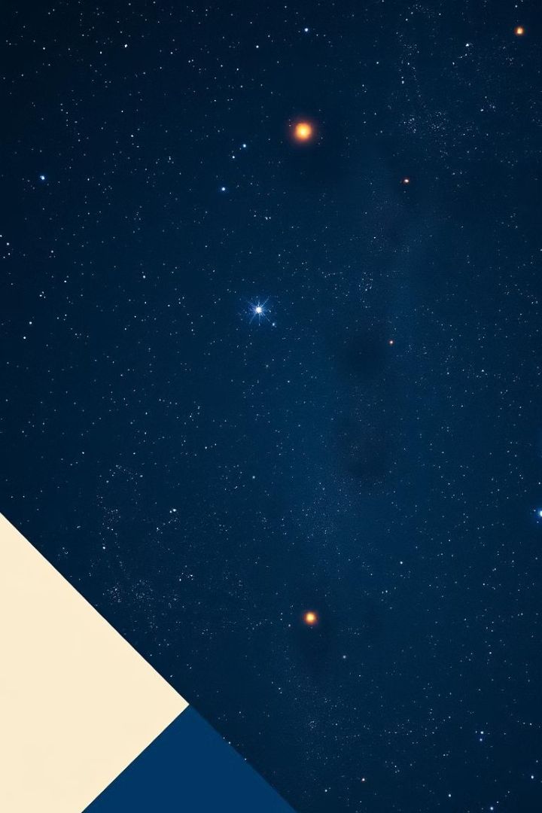


Capstone Project: Stellar Classification
by Acinta Sofiya

Slide 2
Agenda
1.Decoding The Cosmos
2.Problem Statement
3.Understanding the Dataset
4.Data Auditing
5.Univariate Analysis
6.Categorical Feature Encoding
7.Bivariate Analysis
8.Feature Engineering and Selection
9.Multicollinearity Reduction
10.Modelling Phases
11.Imbalanced Data
12.Modelling Process after Applying Smote
13.Performance Comparison
14.Best Model
15.Random Forest Model
16.Model Deployment
17.Gradio App
18.Business Insights
19.Conclusion

Slide 3

Decoding the Cosmos
Stellar classification is a fundamental process in astronomy that enables the differentiation of celestial bodies based on their unique spectral signatures. By analyzing the light emitted or absorbed by stars, galaxies, and quasars, astronomers can categorize these objects and gain valuable insights into their distribution and behavior across the universe.
The ability to accurately classify these celestial bodies is essential for advancing our understanding of the cosmos. Through the application of statistical and machine learning techniques, astronomers can leverage the distinct spectral properties of these objects to develop robust classification systems, ultimately unlocking a deeper, more comprehensive view of the structures and processes that shape the universe.

Slide 4

Problem Statement
The classification of celestial objects, such as stars, galaxies, and quasars, is essential for advancing our understanding of the universe's structure and evolution. Traditional methods of stellar classification rely heavily on manual analysis of spectral characteristics, which can be time-intensive and subject to human error. With the vast amount of data generated by astronomical surveys, such as the Sloan Digital Sky Survey (SDSS17), there is a critical need for automated methods that can accurately categorize these objects based on their unique spectral properties.
This project aims to develop a machine learning model capable of classifying stars, galaxies, and quasars based on their spectral data from SDSS17. By automating this classification process, we seek to enhance the efficiency and accuracy of stellar categorization, contributing to the field of astronomy with a scalable tool for celestial object identification and research.

Slide 5
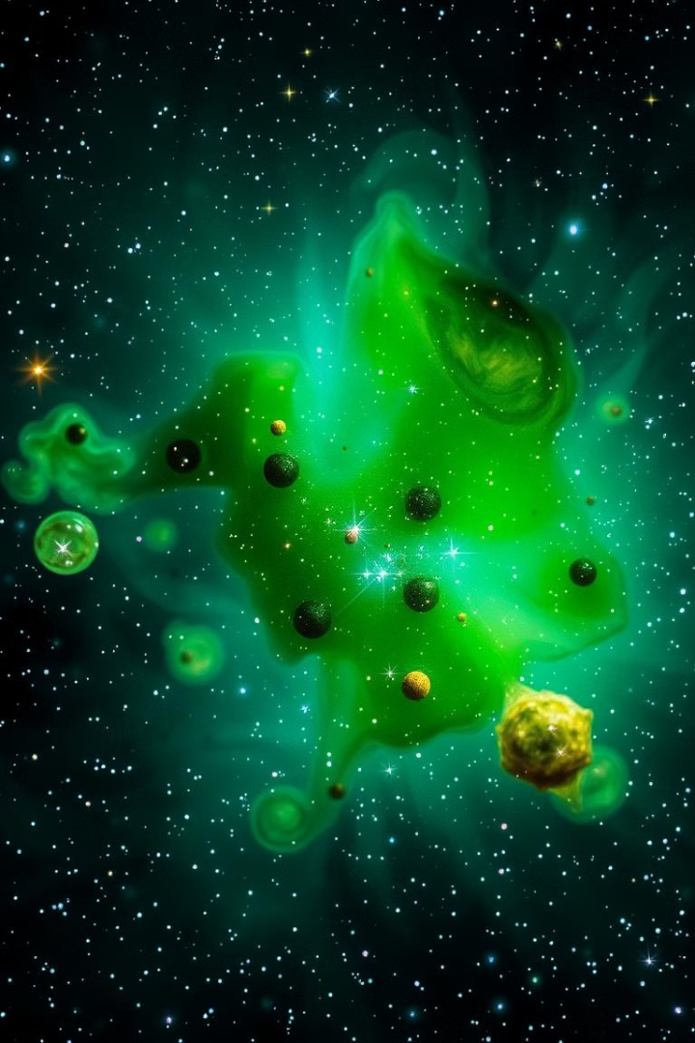
Understanding the Dataset
The dataset used for this project consists of 100,000 entries, each represented by 18 distinct features. These features are divided into three categories: 10 continuous features (float64), 7 discrete features (int64), and 1 categorical feature (object). The dataset is a rich source of information about celestial objects, providing a diverse range of attribute for analysis and model training.
Right Ascension (alpha) and Declination (delta) are essential for accurately locating objects in the sky. Right Ascension measures an object's east-west position, similar to longitude on Earth, while Declination measures its north-south position, analogous to latitude. These coordinates enable astronomers to precisely pinpoint the location of stars, galaxies, and quasars within the observed field.

Slide 6

Photometric filters are essential tools in astronomy, providing insights into the composition and properties of celestial objects. These filters are designed to capture light from specific wavelengths, offering a spectrum of information. The u-band filter captures ultraviolet light, revealing hotter, younger stars. The g- and r bands capture visible light, determining an object's overall color and brightness. Finally, the I - and z -bands capture near-infrared and infrared light, allowing astronomers to study cooler, older objects obscured by interstellar dust.
Redshift is a fundamental concept in astrophysics, providing valuable insights into an object's distance and motion relative to Earth. As light from a distant object travels through the expanding universe, its wavelengths are stretched, causing a shift towards the red end of the spectrum. The redshift value quantifies this shift, revealing the object's velocity and its place in the cosmic landscape.
Class is the target variable in this project, representing the type of celestial object being observed. The dataset categorizes each object as a star, galaxy, or quasar. The primary goal of this project is to classify these distinct celestial objects based on their spectral and positional attributes.

Slide 7

Data auditing
Data Overview: The dataset contains 100,000 entries for each variable, indicating a well-populated dataset for analysis.
High Variability in Identifiers: Both obj_ID and spec_obj_ID exhibit extremely high means and standard deviations, suggesting significant variability in unique object identifiers.
Outliers in Measurements: Variables u, g, and z contain negative values (specifically -9999), indicating potential missing or erroneous data that should be addressed.
Redshift Range: The redshift variable has a mean of 0.577 and a maximum of 7.011, suggesting substantial variability and the presence of outliers that need investigation.
Run and Rerun IDs: The rerun_ID has no variability (standard deviation of 0), indicating that this variable may not be useful for analysis.
Potential Multicollinearity: High correlations observed among variables may imply redundancy, necessitating further investigation into multicollinearity.

Slide 8
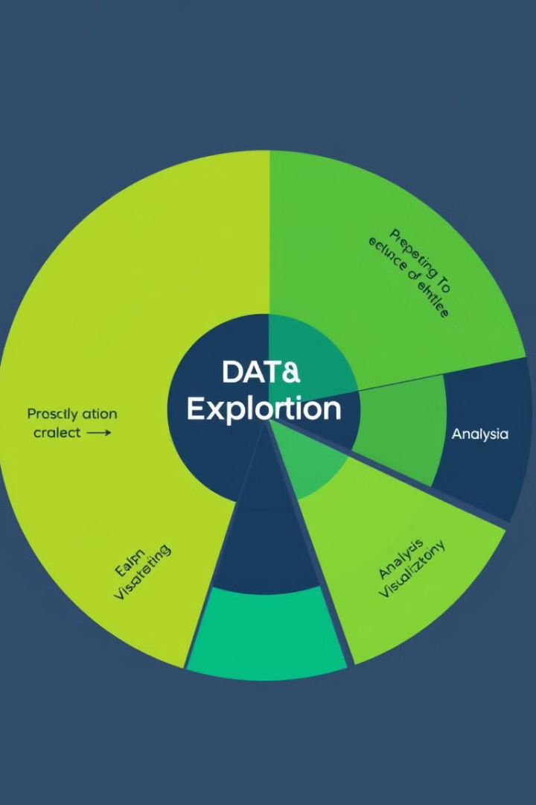
Univariate Analysis
Class Distribution
Imbalance Noted:
The dataset is imbalanced, with galaxies representing 59% of the total entries.
Stars and quasars have significantly lower proportions, which may affect model performance and generalizability.

Slide 9

Categorical Feature Encoding
Encoding Process
Feature: class
Encoding Method: Mapping categorical values to numerical representations.
Mapping: GALAXY: Mapped to 0 QSO: Mapped to 1 STAR: Mapped to 2
Purpose of Encoding: Numerical Representation: Converts categorical data into a numerical format that can be processed by machine learning algorithms.

Slide 10

Feature Removal
After careful analysis, we discovered several features that were not essential for accurate classification. These features, including run ID, rerun ID, camera column, field ID, spectroscopic object ID, and object ID, were removed to streamline the model and improve its performance. By focusing on the most relevant features, we were able to enhance the model's ability to distinguish between stars, galaxies, and quasars.

Slide 11

Bivariate Analysis
In this analysis, Pearson and Spearman correlation methods were used to examine multicollinearity among the variables. The analysis revealed a high correlation between the following pairs: the correlation between variables i and z is 0.97, indicating a very strong relationship. Additionally, the correlation between r and z is 0.92, also reflecting a significant association. Furthermore, a correlation of 0.93 was observed between g and r, and the correlation between r and g is 0.93 as well. These results highlight the presence of multicollinearity among the variables, suggesting potential challenges in regression modeling.

Slide 12

Feature Engineering and Selection
New Feature Creation
Dropped Features
To enhance the model's understanding of relationships between photometric bands, we calculated photometric differences by subtracting values from adjacent bands. These differences were then used to create new features:
To mitigate multicollinearity and reduce the model's dimensionality, the following features were removed:
u, g, r, i, z
u_g: u−g
This simplification resulted in a more efficient and interpretable model, while maintaining its ability to distinguish between stars, galaxies, and quasars.
g_r: g−r
r_i: r−i
i_z: i−z
This approach aims to improve model performance by providing additional information about the spectral characteristics of celestial objects.

Slide 13

Multicollinearity Reduction
Engineered New Features: Calculated photometric differences between adjacent bands (u-g, g-r, r-i, i-z) to capture spectral characteristics.
Removed Redundant Features: Eliminated highly correlated variables (u, g, r, i, z) to address multicollinearity and improve model interpretability.
Streamlined Model: The reduced feature set led to a more efficient and reliable classifier, better able to distinguish between stars, galaxies, and quasars.

Slide 14

Modeling Process
The Model_Evaluation_Pipeline function facilitates the evaluation of machine learning models by systematically splitting the dataset into training and testing subsets (80% and 20% respectively) using stratified sampling.
It supports various scaling methods, such as StandardScaler, MinMaxScaler, and RobustScaler, which are applied to enhance model performance.
A pipeline is constructed, incorporating the selected scaler and the specified model, while hyperparameter tuning is conducted using GridSearchCV with 5-fold cross-validation to optimize for the F1 score.
The best model is trained and makes predictions on both training and testing sets, with performance metrics—accuracy, precision, recall, and F1-score—calculated for each set.
Detailed classification reports and confusion matrices are generated to provide insights into model performance. Finally, the evaluation results are stored in a DataFrame, final_best_models, which includes the model name, scaling method, and various performance metrics.

Slide 15
Imbalanced Data
The dataset is imbalanced, with more instances of the "Galaxy" class compared to others. To address this, SMOTE (Synthetic Minority Over-sampling Technique) was applied. SMOTE works by generating synthetic samples for the minority classes instead of duplicating existing ones. It does this by randomly selecting a sample from the minority class, finding its k-nearest neighbors, and creating new samples along the line segments joining the original sample to its neighbors. This technique helps balance the dataset, improving model performance and reducing bias toward the majority class.

Slide 16

Modeling Process after applying SMOTE
After applying SMOTE to balance the classes, the same modeling process was repeated. The dataset was split into training and testing sets, scaling methods (StandardScaler, MinMaxScaler, or RobustScaler) were applied as needed, and a pipeline was created for each model. Hyperparameter tuning was conducted using GridSearchCV with 5-fold cross-validation to optimize the F1 score. The best-performing model was then evaluated on training and testing data, with metrics (accuracy, precision, recall, and F1-score) recorded for each set. The results, including classification reports and confusion matrices, were stored in the final_best_models Data Frame.

Slide 17

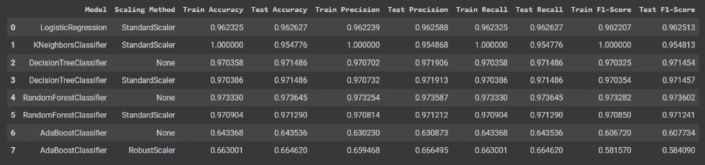
Performance Comparison
The Random Forest Classifier without any scaling (row 4) achieved the best performance among all models, with a training accuracy of 97.33% and a test accuracy of 97.36%. This model also showed high precision, recall, and F1-scores across both training and testing sets, indicating strong generalization and robustness. The high accuracy and consistent performance metrics suggest that Random Forest performed well without additional tuning or scaling, making it the optimal choice for this dataset.

Slide 18
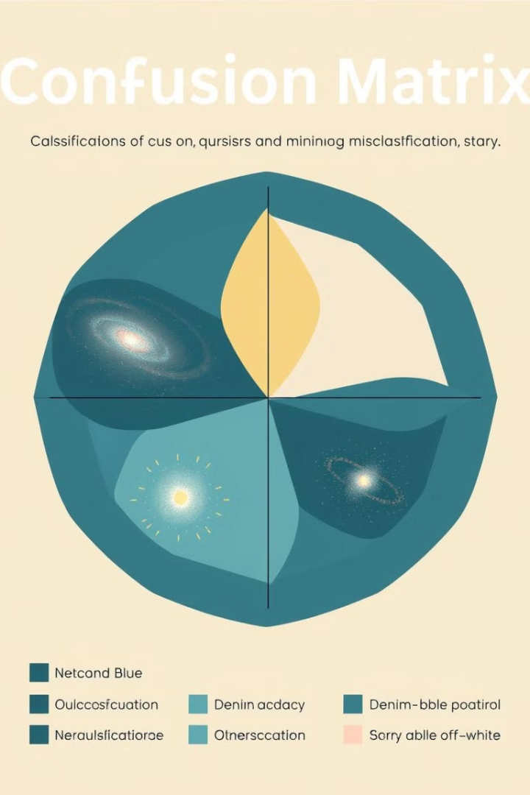
Best Model
In the model evaluation process, various algorithms were employed, including Logistic Regression, K-Nearest Neighbors (KNN), Decision Tree, Random Forest, and AdaBoost. After thorough evaluation, the Random Forest model emerged as the best performer, demonstrating superior accuracy and overall effectiveness compared to the other models. This selection underscores the importance of leveraging ensemble methods, like Random Forest, for enhanced predictive performance in complex datasets.
Metric
Train Score
Test Score
Accuracy
0.97
0.97
Precision
0.97
0.97
Recall
0.97
0.97
F1-Score
0.97
0.97

Slide 19

Random Forest Model
A Random Forest is a powerful machine learning algorithm that belongs to the family of ensemble learning methods.
It operates by constructing multiple decision trees during the training phase and then outputs the class that is the mode of the classes (classification) or mean prediction (regression) of the individual trees.

Slide 20

How Does it Work?
Decision Tree Creation:
Random Sampling: A random subset of data points is selected from the training dataset.
Feature Selection: A random subset of features is considered at each node of the tree.
Node Splitting: The best split point is chosen based on a criterion like information gain or Gini impurity.
Tree Growth: The tree continues to grow until a stopping criterion is met, such as a maximum depth or minimum number of samples per leaf node.
Ensemble Learning:
Multiple Trees: Many decision trees are created, each trained on a different random subset of the data.
Diversity: The randomness in the feature selection and data sampling ensures that each tree is different and makes independent decisions.
Aggregation: The predictions of all the trees are combined to make a final prediction. For classification, the majority vote is taken. For regression, the average of the predictions is used.

Slide 21

Model Deployment
The final Random Forest classifier model, which demonstrated the highest accuracy and performance metrics, has been saved for deployment. This model was selected after evaluating multiple classifiers, and it consistently outperformed others in both training and testing accuracy, making it the most reliable for the task.
During deployment, the model takes input data related to astronomical objects and applies its learned patterns to classify each object into one of three categories: Galaxy, Star, or Quasar. This classification is based on complex patterns identified during training, allowing for precise categorization of objects based on their features. By deploying the Random Forest model, the system can efficiently automate this classification process, providing quick and accurate results that support further analysis or applications in astronomy.

Slide 22
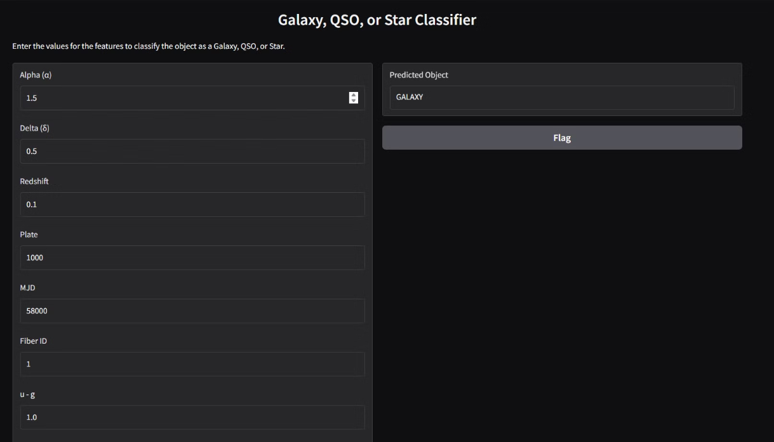
Gradio app
A Gradio app was created to facilitate the classification of stars based on their properties. This user-friendly interface allows users to input various star attributes and receive real-time classifications.

Slide 23

Business Insights
Astronomical Research Advancement:
Resource Allocation:
Resource Allocation:
Insights gained can help allocate resources effectively in observational astronomy, determining which stars to prioritize for further study based on their classification and potential significance.
Insights gained can help allocate resources effectively in observational astronomy, determining which stars to prioritize for further study based on their classification and potential significance.
The project can contribute to the scientific community by providing a robust dataset for further research in astrophysics and cosmology, potentially leading to new discoveries about the universe.

Slide 24

Conclusion
In summary, the star classification project combines machine learning with astronomical research to enhance the understanding of stellar properties. Significant insights were achieved, leading to promising applications such as educational tools and potential collaborations with space agencies.

